Slide 1
FareFlow: An IoT and Cloud-Based Smart Bus Fare Collection System for Sustainable Urban Transport
PUTSHU LUNGHE SAMUEL
ISBAT UNIVERSITY

Slide 2
Content
Introduction
Research Motivation
Literature Review
Methodology
Models and Analysis
Results and Discussions
Conclusion
Acknowledgements

Slide 3
Introduction
The Problem: Public transport in Uganda relies on manual, cash-based fare collection.
Key Challenges:
Inefficiency & Long Boarding Times
Revenue Leakage & Lack of Transparency
Theft Risks & Hygiene Concerns in few seen cases (e.g., COVID-19)
The Opportunity: Advancements in IoT, Cloud Computing, and Contactless Payments.
The Solution: This study proposes FareFlow – a smart, RFID-based fare system to modernize urban transport.

Slide 4
Research Motivation
Addressing Local Needs: To solve the specific inefficiencies plaguing Uganda's public transport sector.
Sustainable Development: Contributing to the UN Sustainable Development Goals (SDGs):
SDG 9: Industry, Innovation, and Infrastructure.
SDG 11: Sustainable Cities and Communities.
Technological Gap: While developed countries use smart fare systems, adoption in Africa is limited due to cost and lack of localized solutions.
Goal: To design an affordable, efficient, and transparent system using cost-effective components.

Slide 5
Literature Review
RFID in Transport: Oberli et al. (2010) showed UHF RFID's potential for real-time passenger recognition in public transit.
IoT & Cloud Integration: Al-Kababji et al. (2019) demonstrated reliable real-time data handling using Firebase, applicable to transport.
Open-Source & Low-Cost Tools: Studies highlight the role of platforms like Firebase, Express.js, React, and NodeMCU in creating scalable, affordable solutions.
Research Gap: These technologies are underutilized in fare collection systems tailored for developing regions like Uganda.

Slide 6
Methodology
System Architecture
MQTT
MQTT
INPUT LAYER
PROCESSING LAYER
OUTPUT LAYER
HTTPS
RFID Reader (RC522),
NodeMCU ESP8266,
GPS Module,
I2C LCD, LEDs, Buzzer
ExpressJS Backend
Firebase Firestore and Real-time Database
Firabase Authentication
SMS and Email Notifications
Web Interfaces Updates

Slide 7
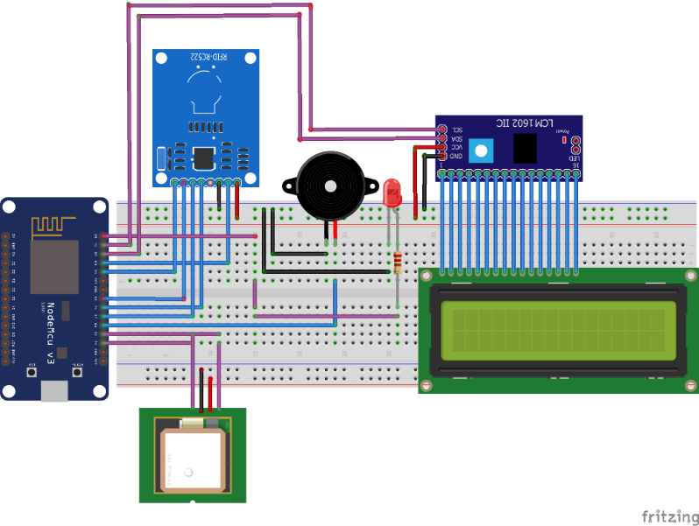
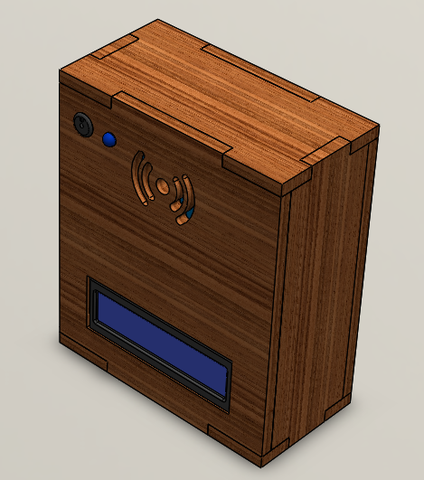
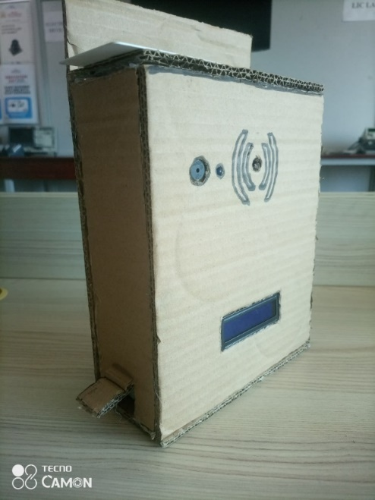
Methodology
Hardware Design
Circuit
Actual Made Prototype
3D Design Model

Slide 8
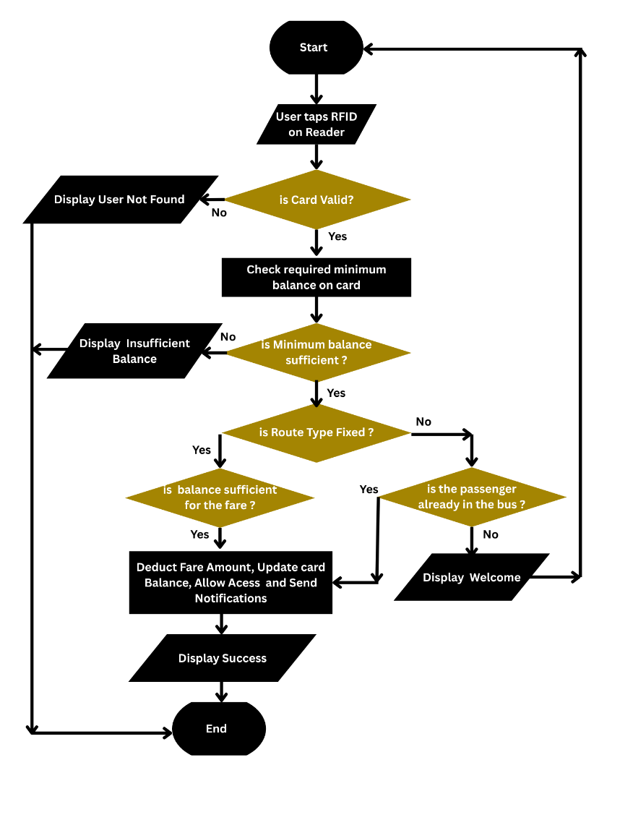
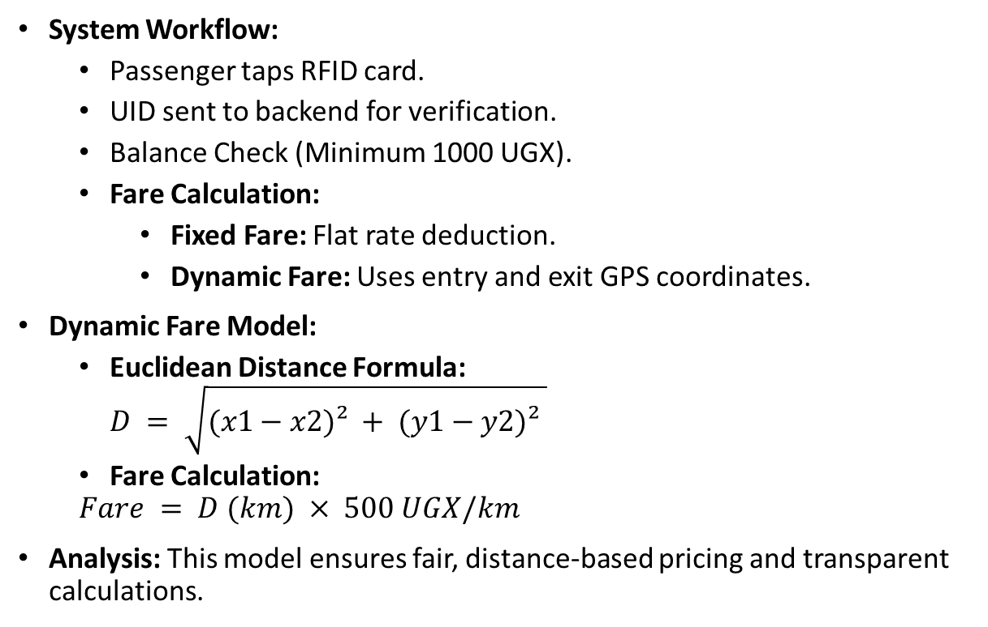
Models and Analysis
System Workflow:
Passenger taps RFID card.
UID sent to backend for verification.
Balance Check (Minimum 1000 UGX).
Fare Calculation:
Fixed Fare: Flat rate deduction.
Dynamic Fare: Uses entry and exit GPS coordinates.
Dynamic Fare Model:
Euclidean Distance Formula: $D = \sqrt{(x1−x2)² + (y1−y2)² }$
Fare Calculation:
$$Fare = D (km) × 500 UGX/km$$
Analysis: This model ensures fair, distance-based pricing and transparent calculations.

Slide 9
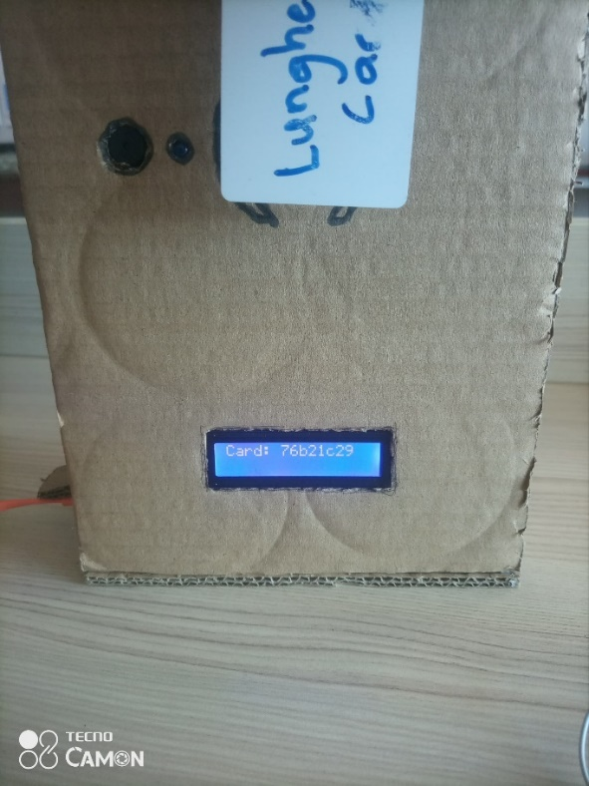
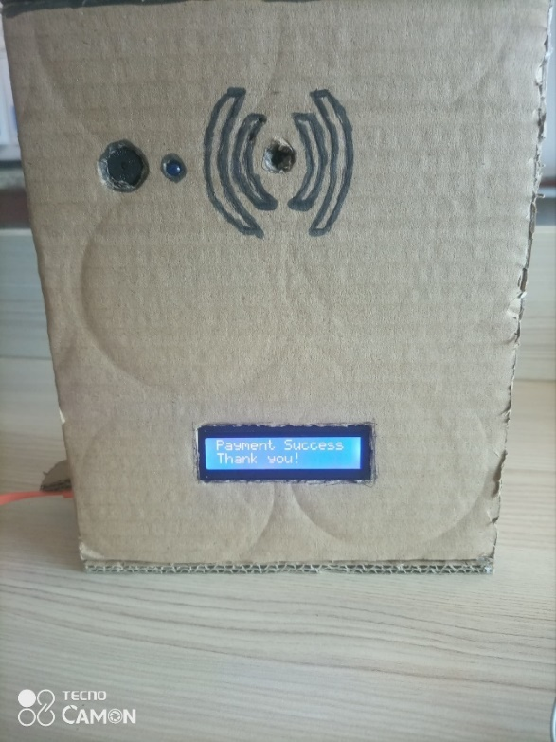
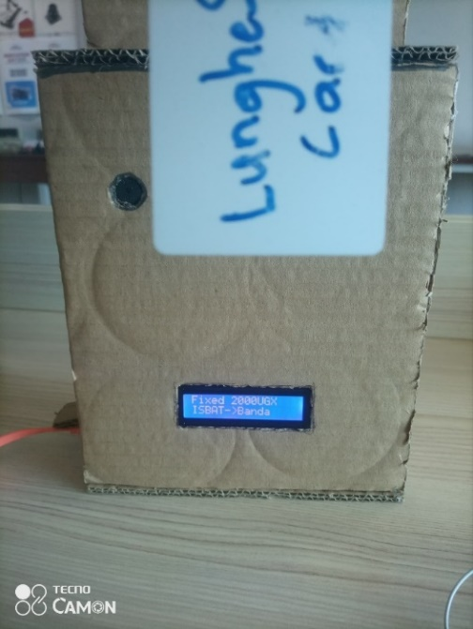
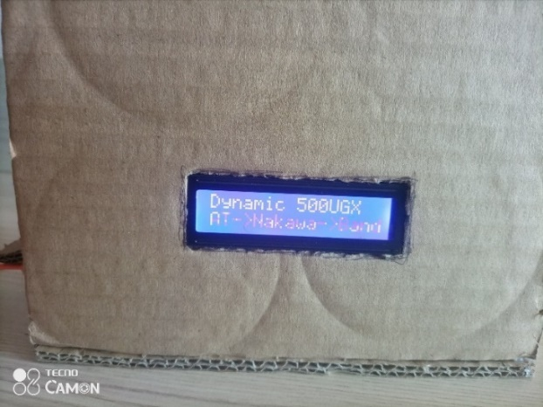
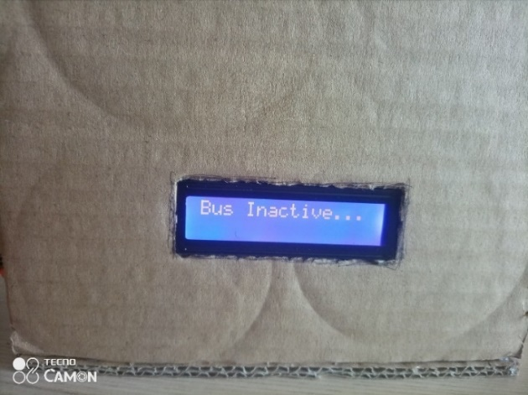
Results and Discussions
Functionalities Tested
Test Case | Expected Result | Outcome
Valid UID with sufficient balance | Fare deducted, LCD success message, SMS/email sent | Passed
Valid UID with insufficient balance | Transaction rejected, LCD error message, alert sent | Passed
Fixed fare route | Flat rate deducted, confirmation sent | Passed
Dynamic route (entry + exit taps) | Distance-based fare calculated and deducted | Passed
Inactive bus | No transactions processed, error displayed | Passed

Slide 10
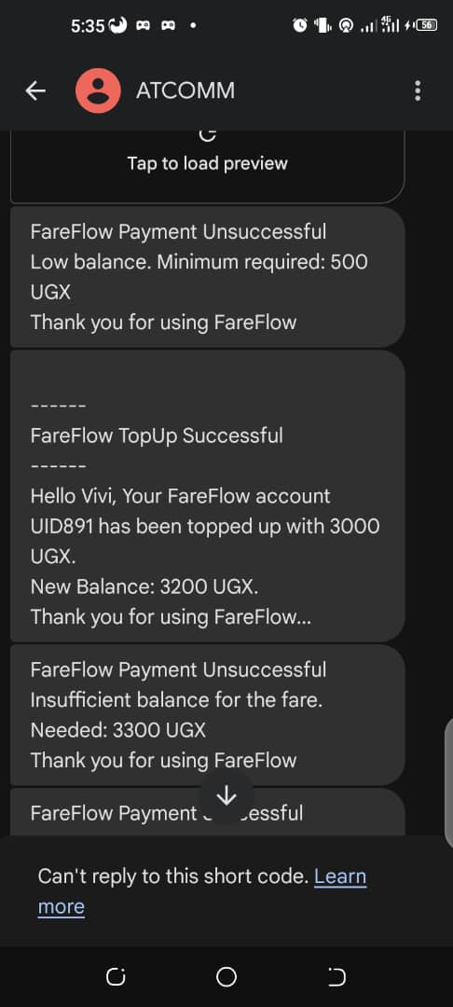
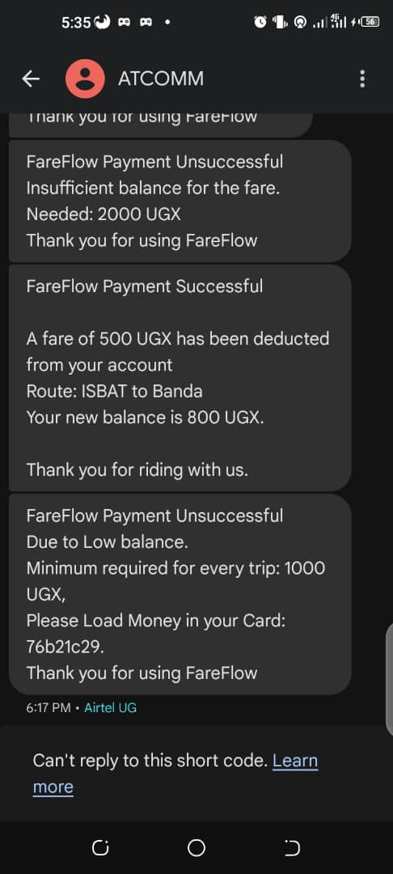
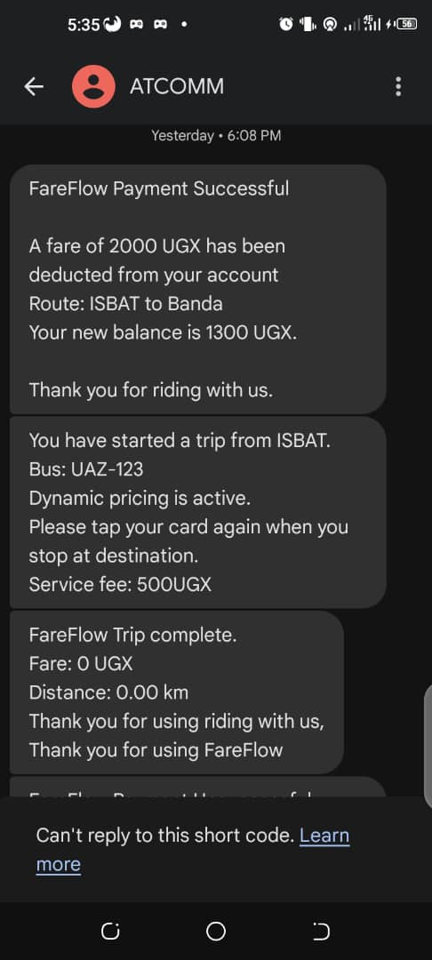
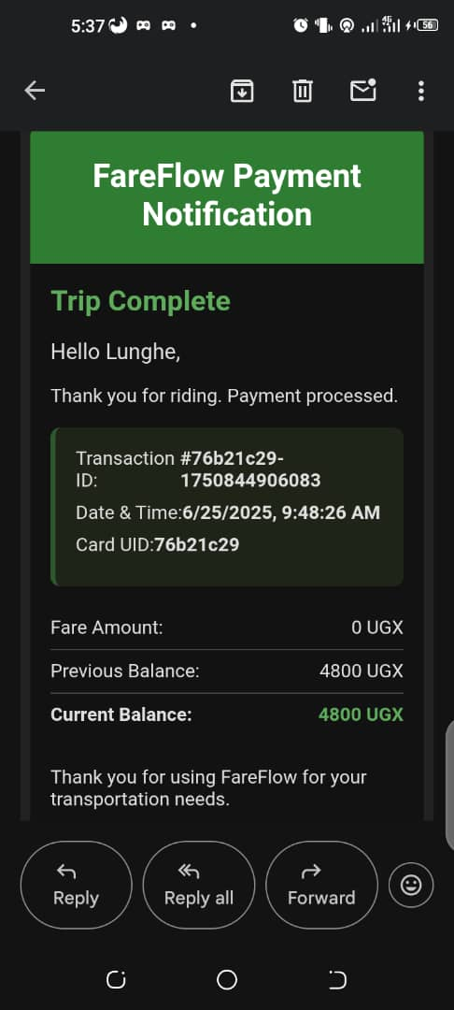
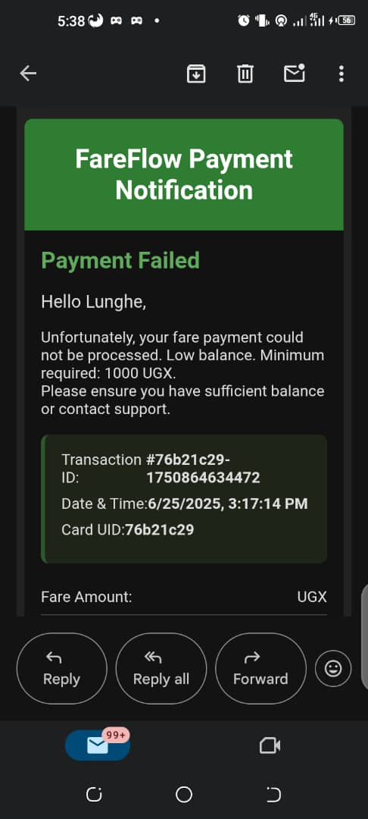
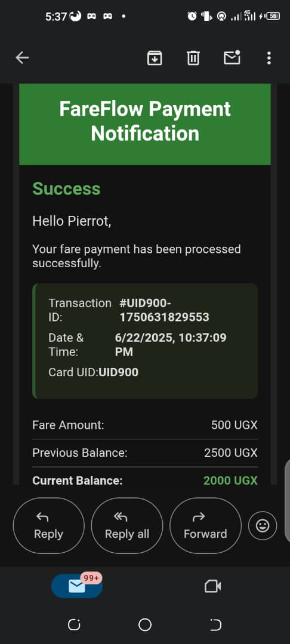
Results and Discussions
SMS Notifications
Email Notifications

Slide 11
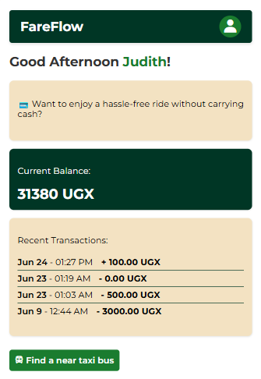
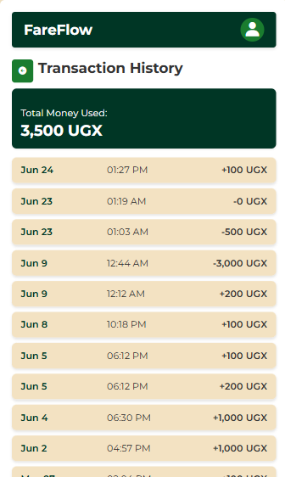
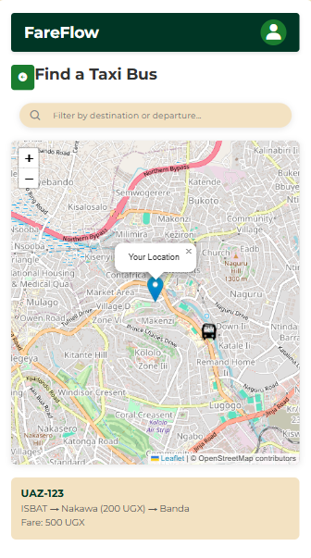
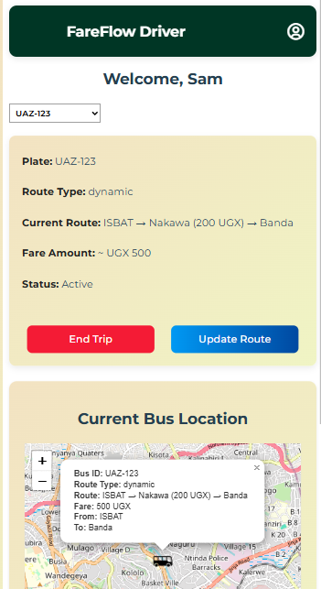

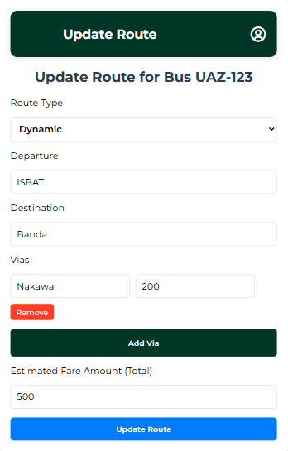
Results and Discussions
Passenger Web UI
Driver/Bus Operator Web UI

Slide 12
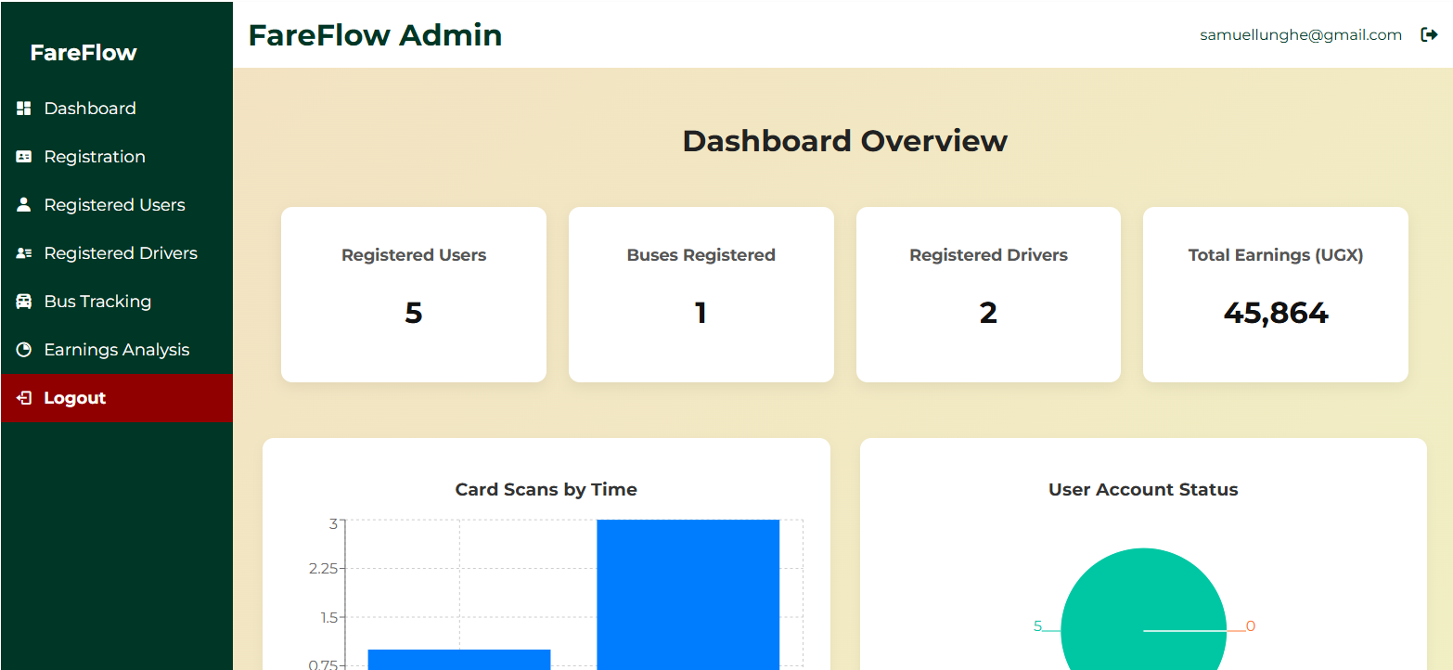
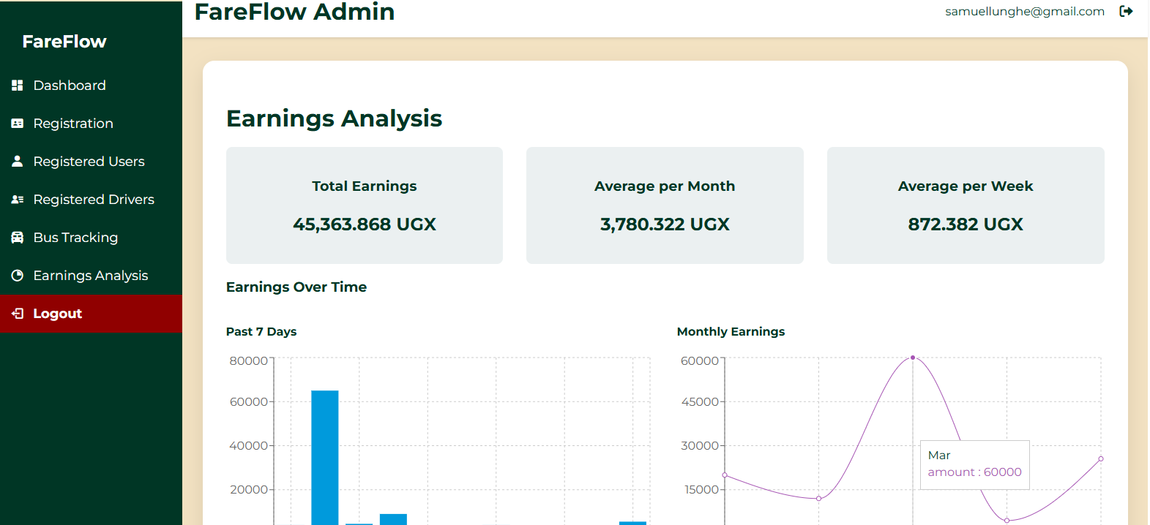
Results and Discussions
Admin Dashboard UI

Slide 13
Conclusion
FareFlow is a feasible, low-cost smart fare system that integrates RFID, IoT, and Cloud technologies.
Key Achievements:
Transparency: Real-time logging and stakeholder notifications.
Accountability: Reduced revenue leakage and human error.
Hygiene Contribution: Contactless payments.
Contribution: Directly supports SDG 9 & SDG 11.
Limitations & Future Work:
Limitations: Internet dependency, non-rugged hardware, limited mobile money integration.
Future Work: Integrate mobile money APIs (e.g., MTN, Airtel) or other similar services, develop rugged hardware casing, and conduct large-scale pilot testing.

Slide 14
Acknowledgements
I would like to express my sincere gratitude to my supervisor, Dr. Mayur Kumar Chhipa, for his invaluable guidance and support throughout this research.
Thanks to the Department of Electronics and Communication Engineering, ISBAT University, for providing the resources and environment for this work.
Thank you to the Organizers of this event for the opportunity to present our research.
Thank You for Your Attention

Slide 15
Thank You

